Slide 1
Deploying Windows Application
Presented by:Er. Sudan Prajapati

Slide 2
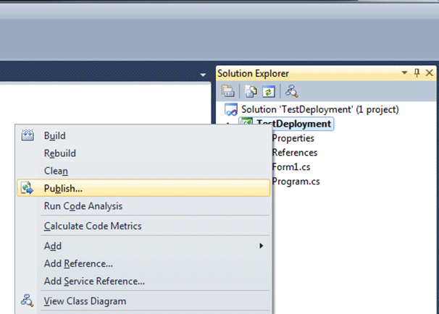
Publishing the Project from Solution Explorer
Right click on the project in solution explorer you want to deploy.
You'll see an option to Publish your project.
Choose this option to bring up the one-click wizard:

Slide 3
Selecting Where to Publish your Deployed App
The wizard will come up and prompt you where you want to publish your software.
You really have a myriad of choices and are not limited to your hard drive
You can publish to a file share server, to the internet via ftp, or even directly to a website
Microsoft auto-magically figures out all the dependencies that need to be published. In this example, we'll use the default

Slide 4
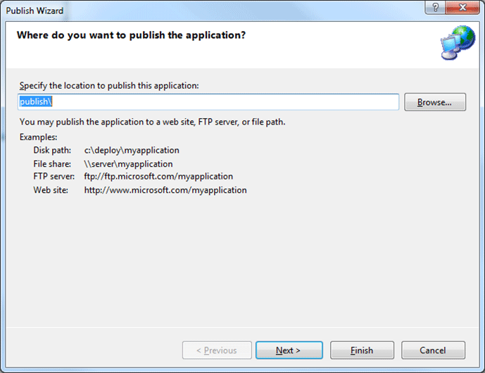

Slide 5
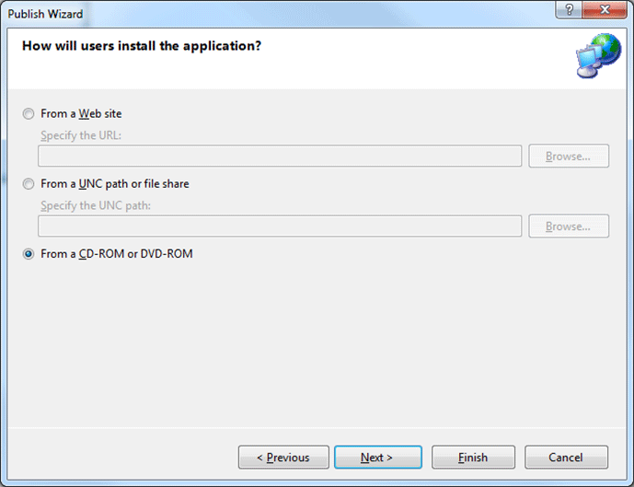
Selecting How Users Will Install the Application
The next step gives you the flexibility of specifying where the user will install the application.

Slide 6
Because of the internet and other networking vehicles, you are no longer limited from installing off of physical media.
If you choose From a Website though, it appears you are limited to IIS as shown in the screen below.
As it states you must have at least IIS 6 installed on the machine that will be deploying the app, and you must be an admin on that machine.

Slide 7
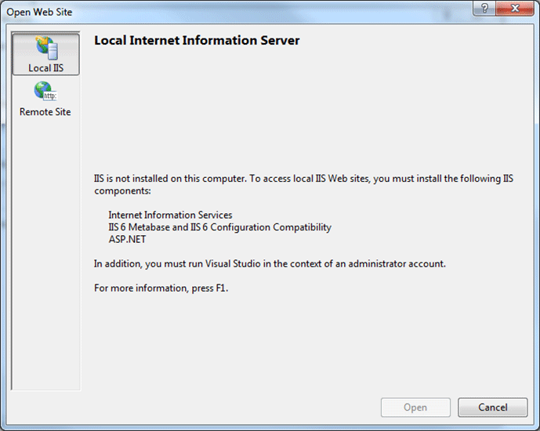

Slide 8
If you do happen to have an IIS Website and are an admin, you can type it in to the Specify the URL field.
After clicking Next, the Wizard will then prompt you whether or not the application will only be served up online or if the application can also run directly from the users machine (offline)

Slide 9
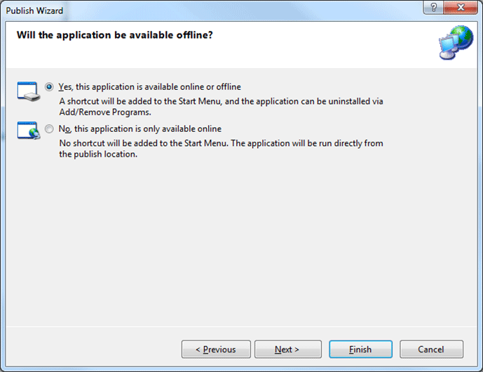

Slide 10
Where the application can check for updates
One of the nice features of Click-Once is that it has a software updating mechanism so the user can update their software whenever a new revision is available.
pick a website to publish from so we can examine the update mechanism.

Slide 11
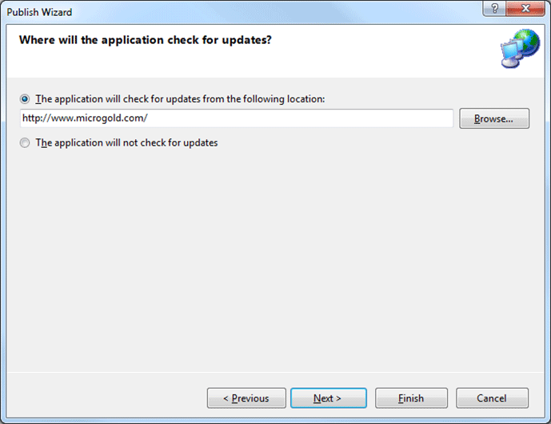

Slide 12
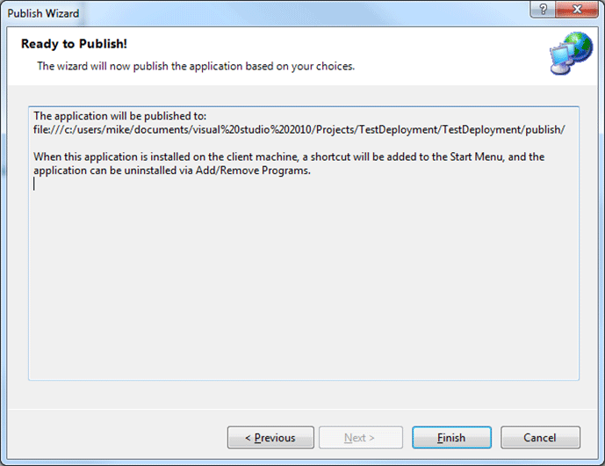
Finished
The final screen tells us where the deployment files will be published and how it will behave on the client machine.

Slide 13
Once you click the finish button, the folder where your deployment files automatically pop up on your machine.
It even gives you an autorun file so that if you install you application on CD.
It will setup your application as soon as the CD is popped into the player.

Slide 14
